Slide 1
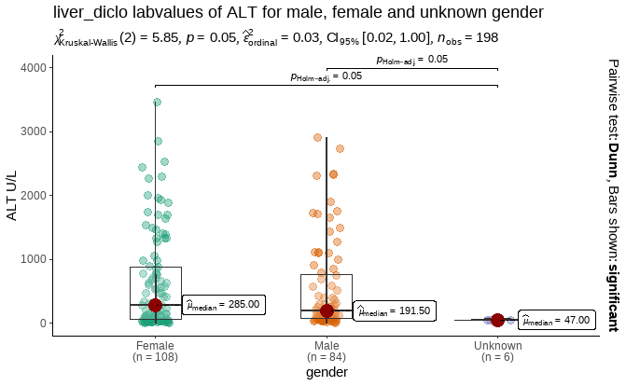
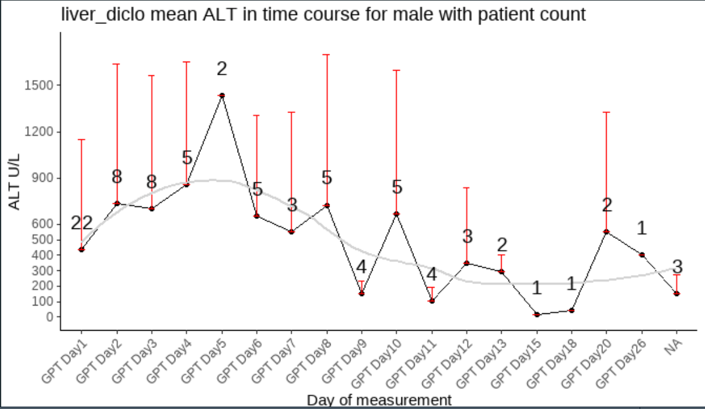
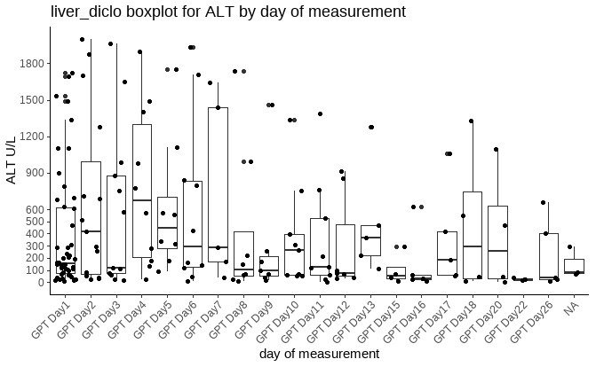
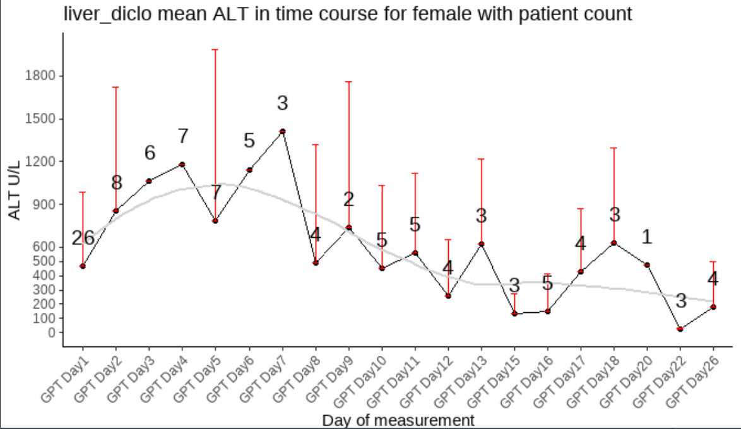
ALT
variable <chr> | gender <chr> | statistic <dbl> | p_value <dbl> | sample <dbl>
labreads | Female | 0.7930576 | 5.022242e-11 | 108
labreads | Male | 0.7282622 | 3.593002e-11 | 84
labreads | Unknown | 0.7506731 | 2.022462e-02 | 6

Slide 2
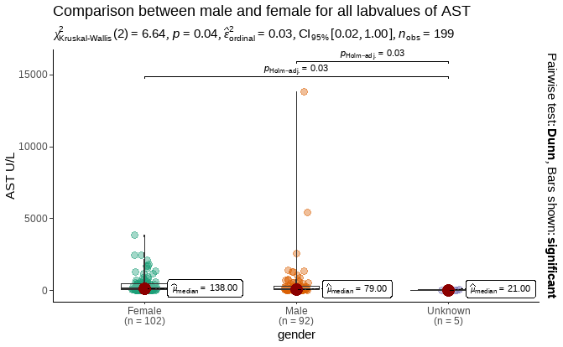
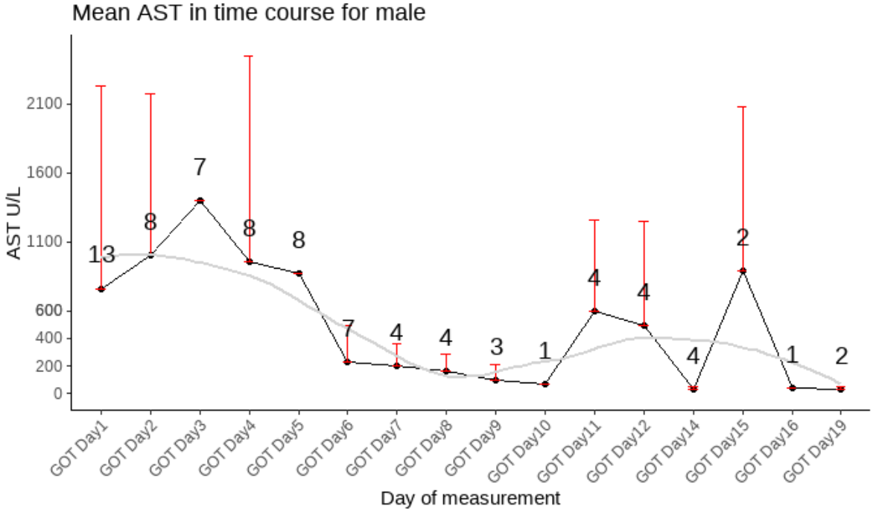
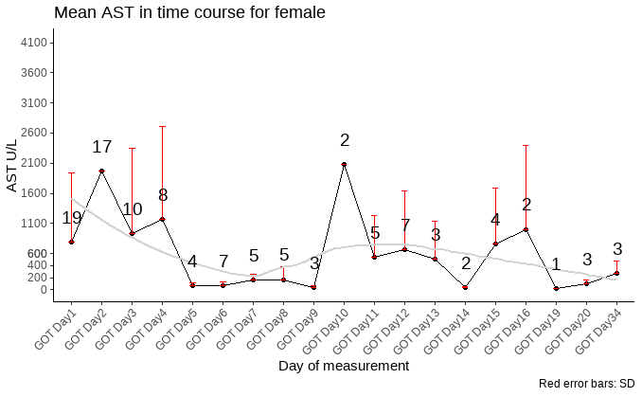
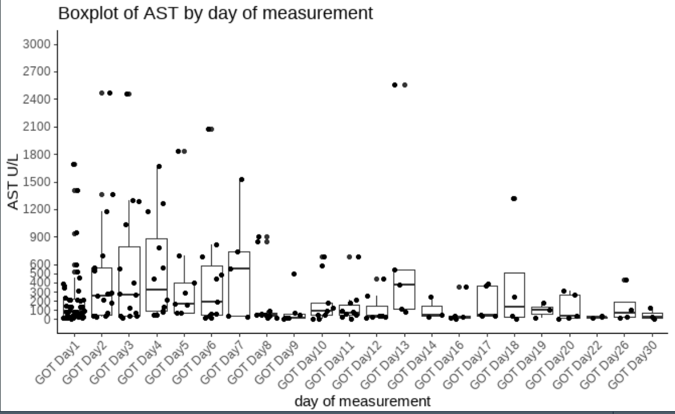
AST
variable <chr> | gender <chr> | statistic <dbl> | p_value <dbl> | sample <dbl>
labreads | Female | 0.6390150 | 1.788699e-14 | 102
labreads | Male | 0.2601560 | 2.177545e-19 | 92
labreads | Unknown | 0.8668231 | 2.537967e-01 | 5

Slide 3
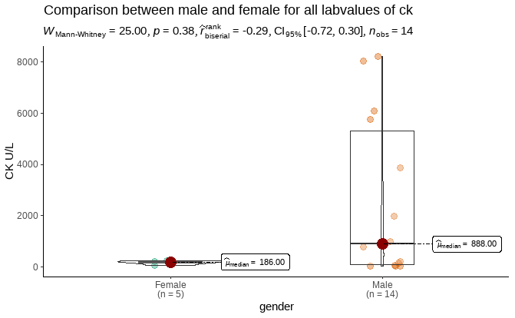
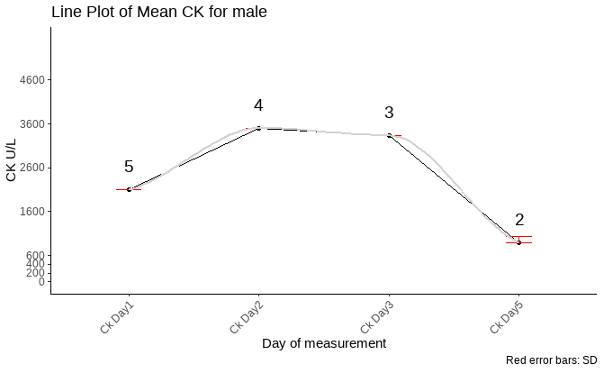
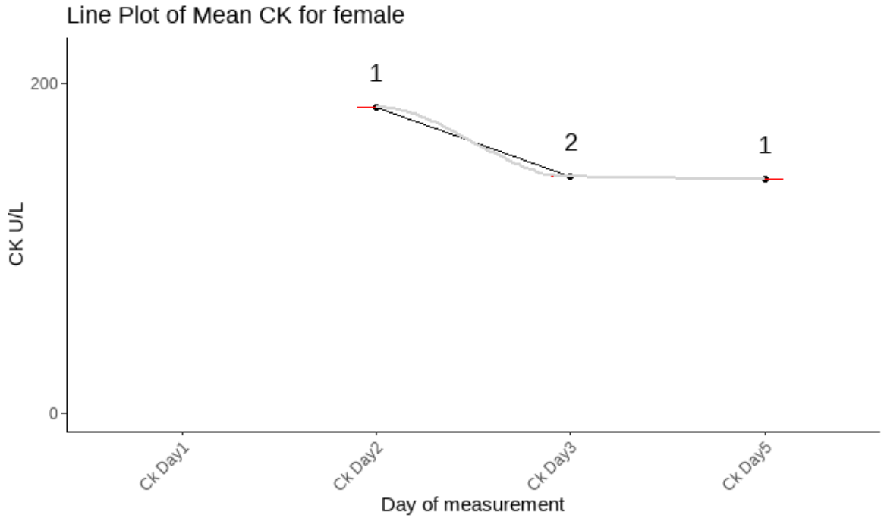
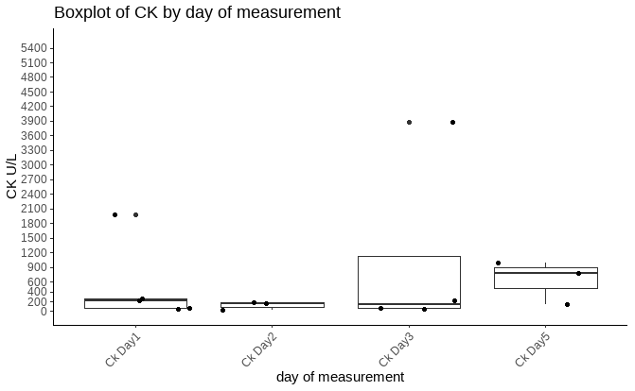
CK
variable <chr> | gender <chr> | statistic <dbl> | p_value <dbl> | sample <dbl>
labreads | Female | 0.9677362 | 0.860534803 | 5
labreads | Male | 0.7848556 | 0.003262458 | 14

Slide 4
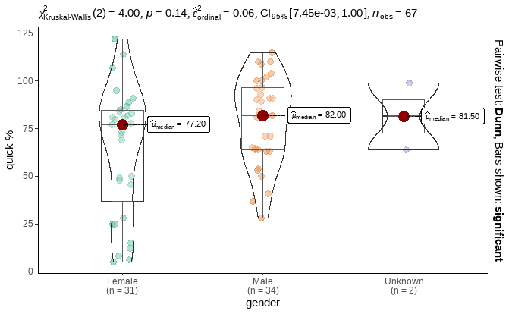
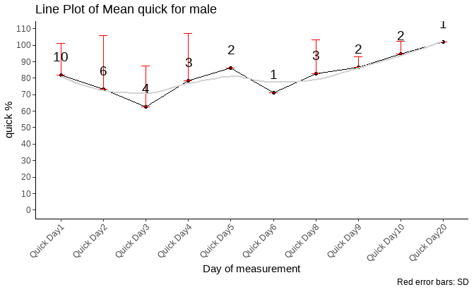
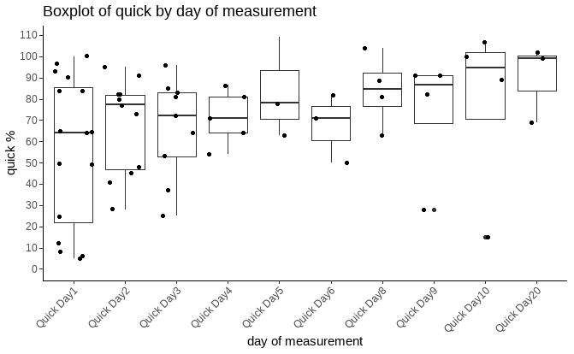
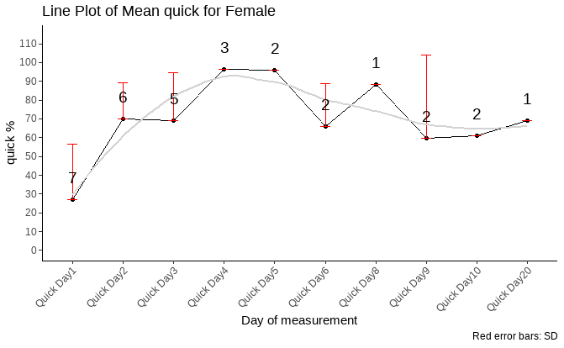
quick
variable <chr> | gender <chr> | statistic <dbl> | p_value <dbl> | sample <dbl>
labreads | Female | 0.9210333 | 0.02514716 | 31
labreads | Male | 0.9614341 | 0.26759440 | 34
labreads | Unknown | NA | NA | 2

Slide 5
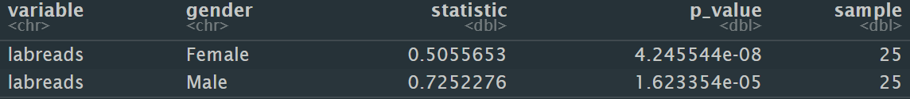
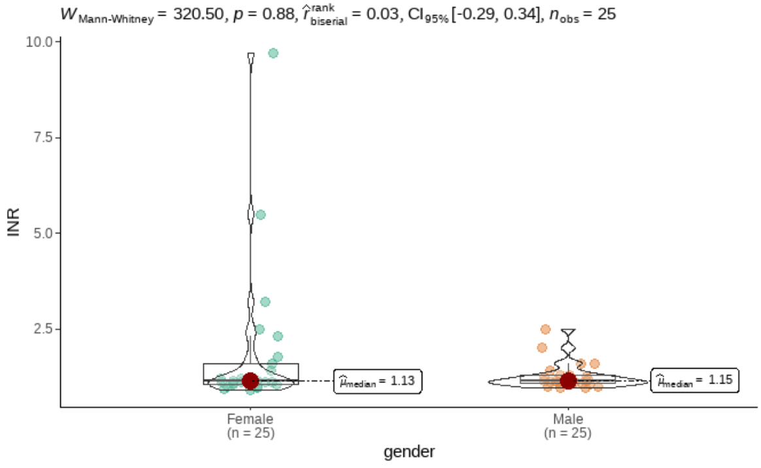
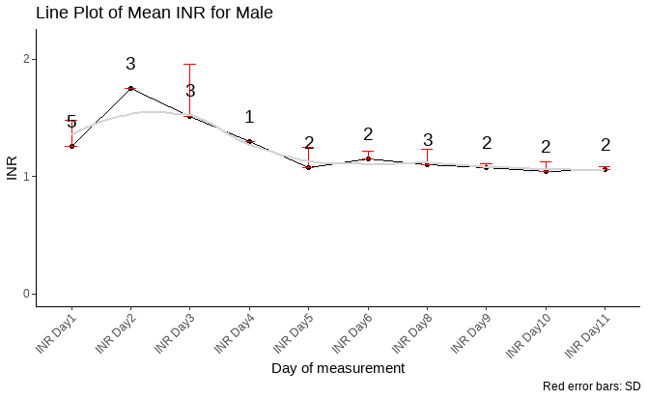
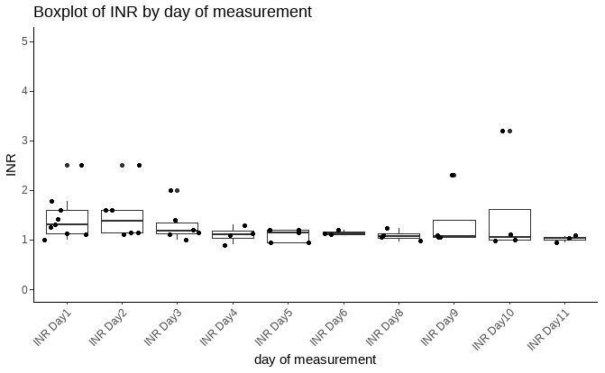
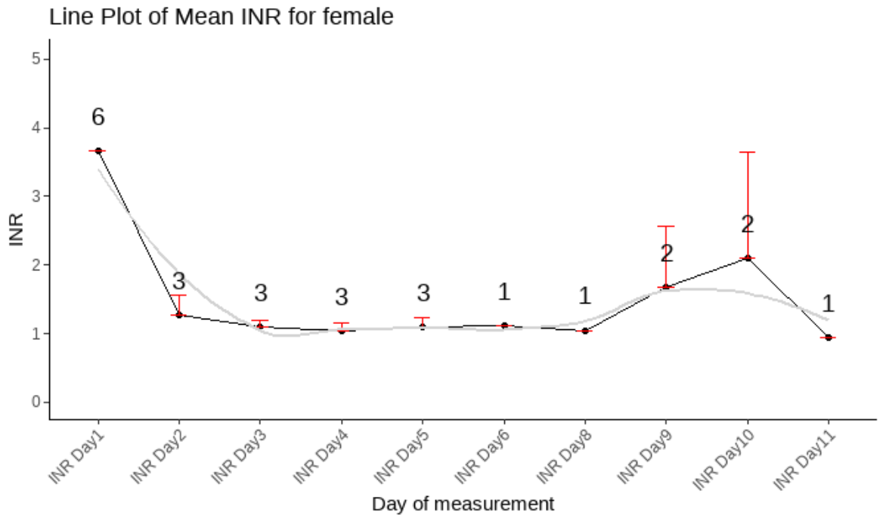
Inr

Slide 6
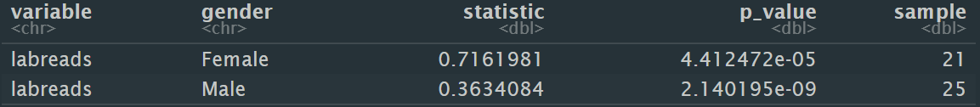
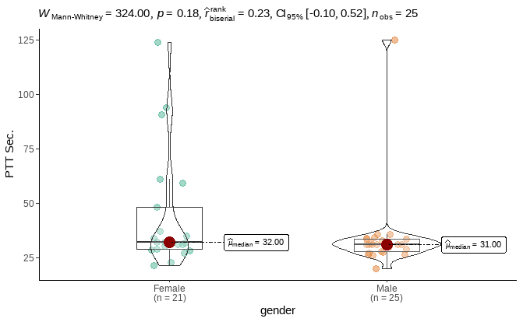
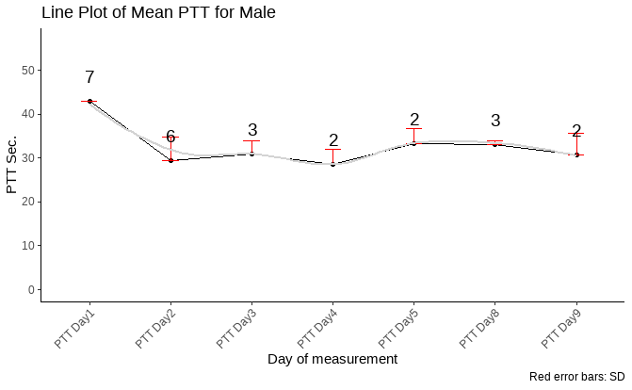
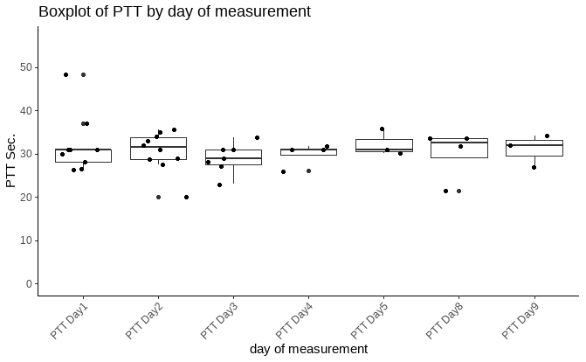
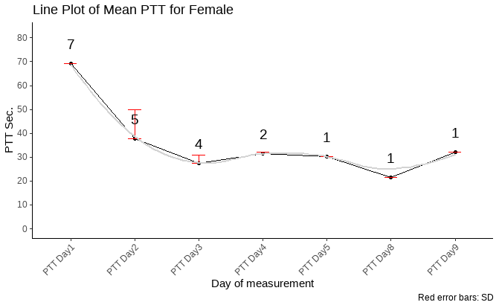
ptt

Slide 7
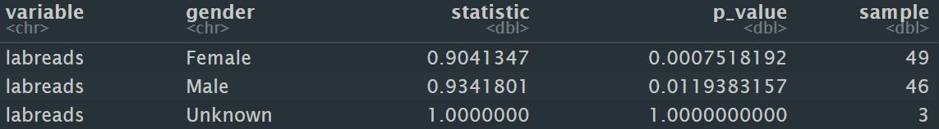
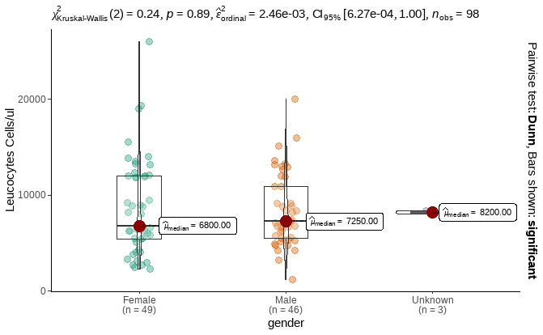
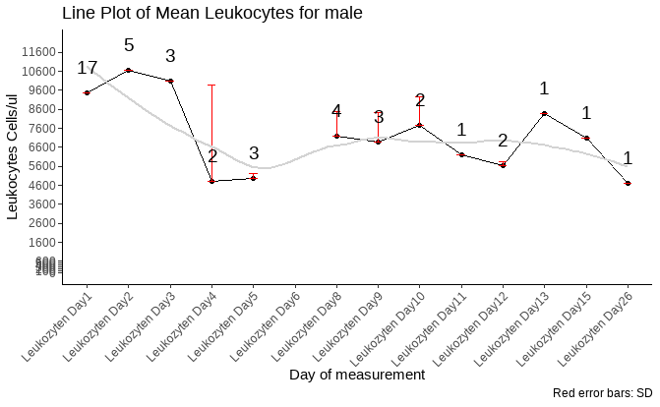
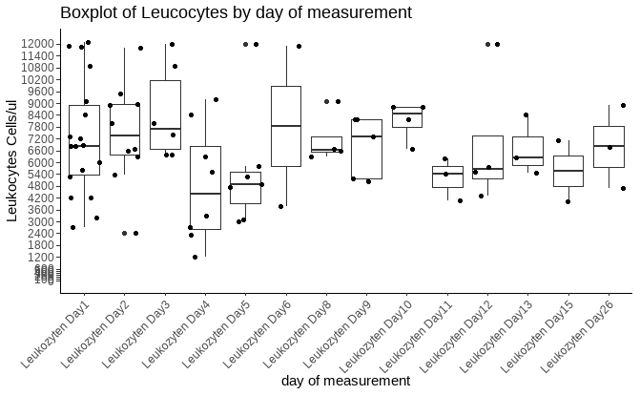
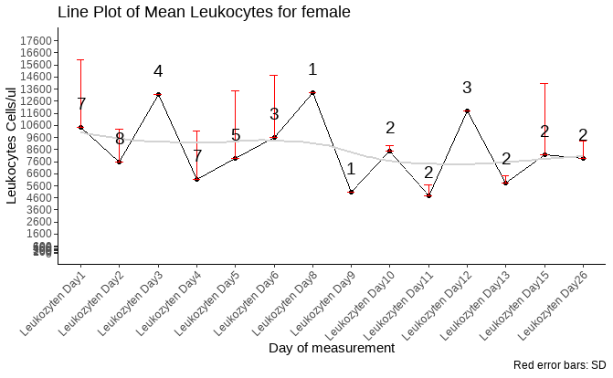
Leukocytes

Slide 8
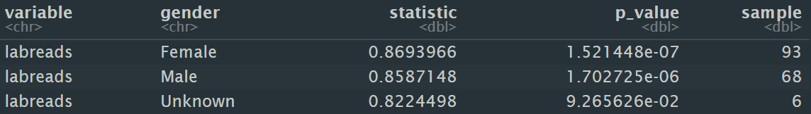
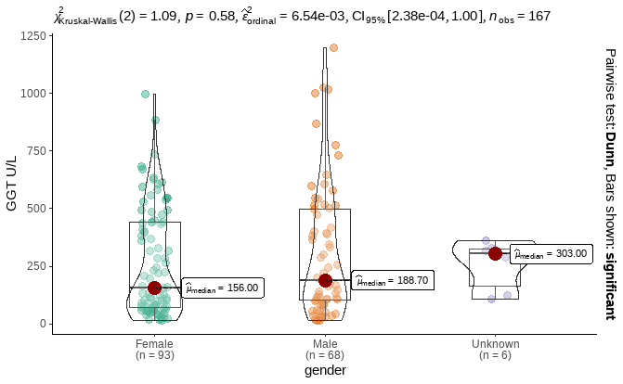
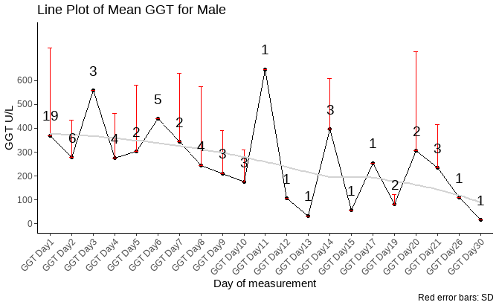
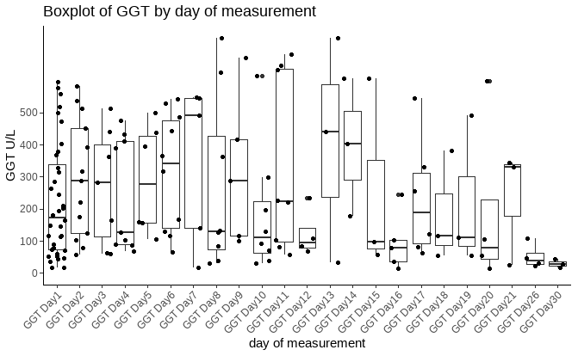
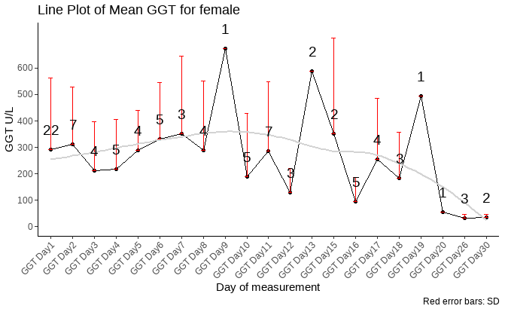
ggt

Slide 9
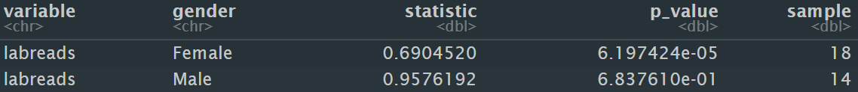
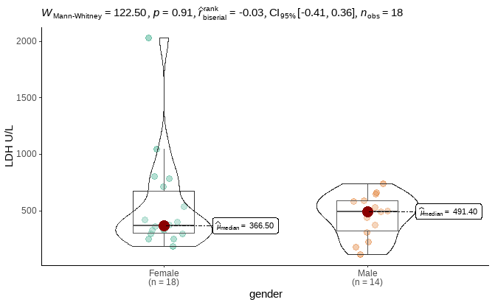
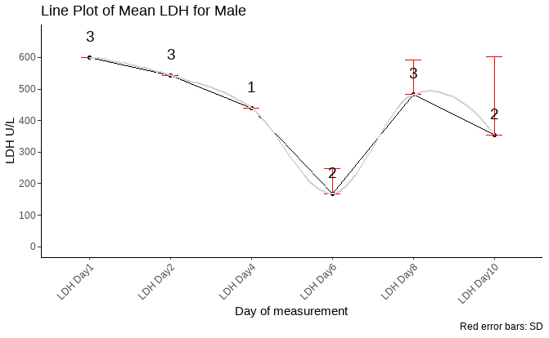
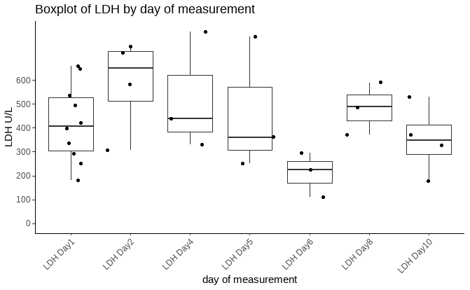
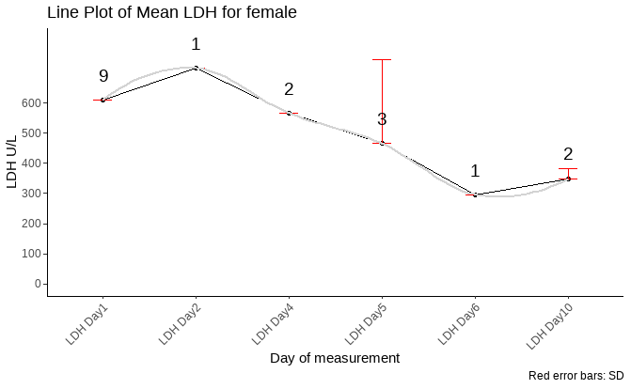
LDH

Slide 10
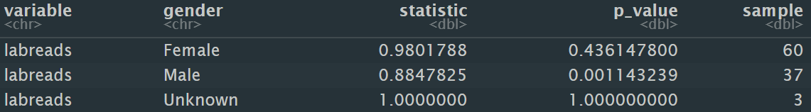
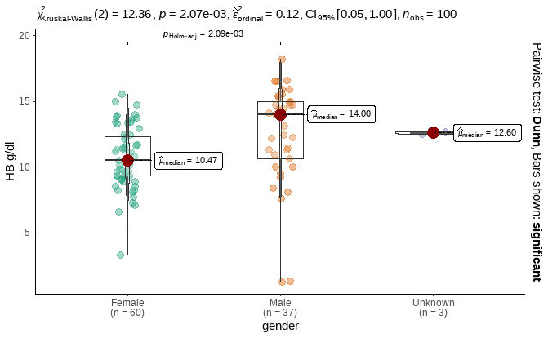
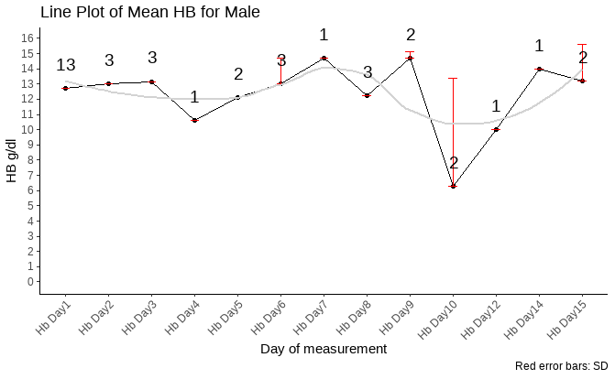
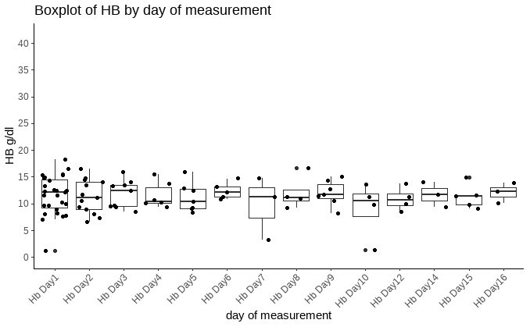
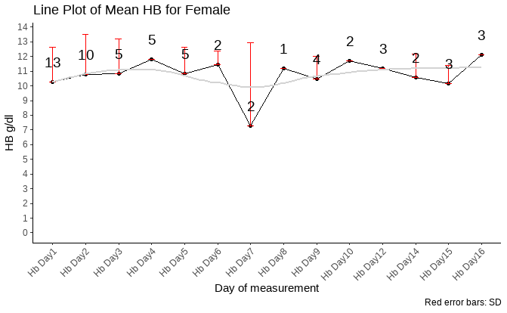
HB

Slide 11
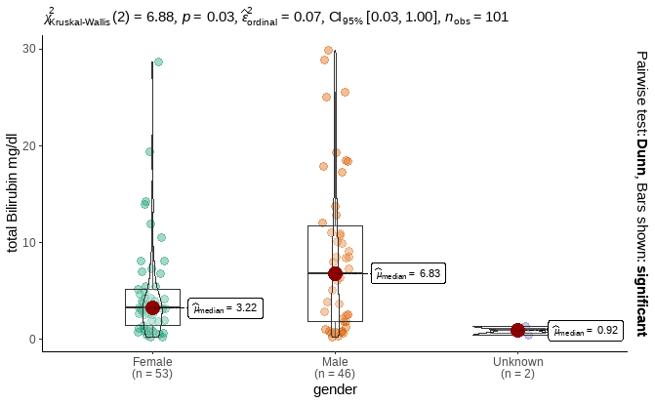
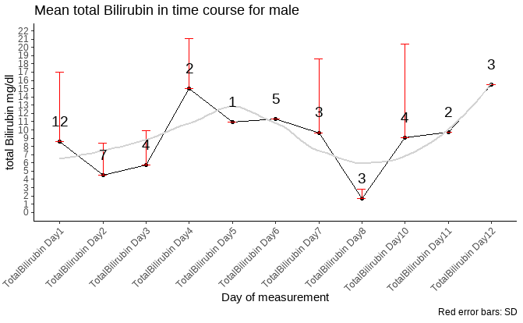
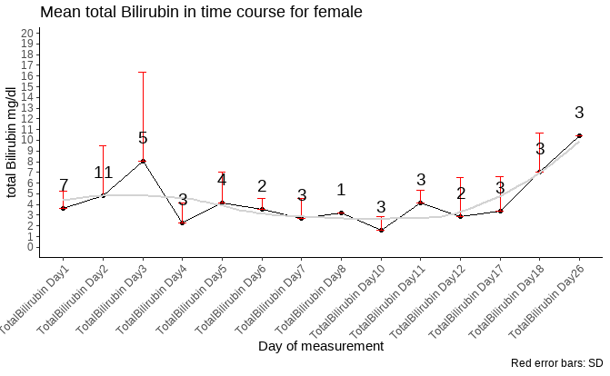
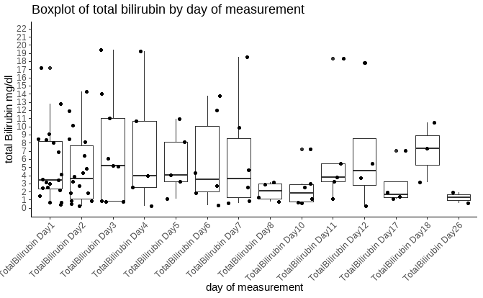
Total Bilirubin
variable <chr> | gender <chr> | statistic <dbl> | p_value <dbl> | sample <dbl>
labreads | Female | 0.7101301 | 6.390384e-09 | 53
labreads | Male | 0.8649679 | 7.714902e-05 | 46
labreads | Unknown | NA | NA | 2

Slide 12




AP
variable <chr> | gender <chr> | statistic <dbl> | p_value <dbl> | sample <dbl>
labreads | Female | 0.9026562 | 2.111096e-04 | 58
labreads | Male | 0.6266958 | 1.424119e-10 | 55
labreads | Unknown | 0.9668353 | 8.217987e-01 | 4

Slide 13





Creatinine

Slide 14





CRP

Slide 15





Urea

Slide 16




Erythrocytes
variable <chr> | gender <chr> | statistic <dbl> | p_value <dbl> | sample <dbl>
labreads | Female | 0.9150230 | 7.919679e-03 | 37
labreads | Male | 0.7069135 | 1.723145e-05 | 23
labreads | Unknown | 1.0000000 | 1.000000e+00 | 3

Slide 17




Thrombocytes
variable <chr> | gender <chr> | statistic <dbl> | p_value <dbl> | sample <dbl>
labreads | Female | 0.9548505 | 0.1114320 | 40
labreads | Male | 0.9535038 | 0.1682671 | 33
labreads | Unknown | 0.9998684 | 0.9780939 | 3

Slide 18





Hematokrit

Slide 19




Sodium
variable <chr> | gender <chr> | statistic <dbl> | p_value <dbl> | sample <dbl>
labreads | Female | 0.9001351 | 0.03520439 | 21
labreads | Male | 0.9130235 | 0.04103897 | 24

Slide 20




Potassium
variable <chr> | gender <chr> | statistic <dbl> | p_value <dbl> | sample <dbl>
labreads | Female | 0.9105457 | 0.01768517 | 29
labreads | Male | 0.9539643 | 0.20061603 | 31

Slide 21





Calcium

Slide 22





Glucose

